Slide 1
Git and GitHub

Slide 2
What is Git?
Git is a free and open source distributed version control system designed to handle everything from small to very large projects with speed and efficiency.
Git is a version control system that you download onto your computer. It is essential that you use Git if you want to collaborate with other developers on a coding project or work on your own project.

Slide 3
Features of Git
Tracks history.
Free and open source.
Supports non-linear development.
Creates backups.
Scalable.
Supports collaboration.
Branching is easier.
Distributed development

Slide 4
Git Init
The git init command is the first command that you will run on Git. The git init command is used to create a new blank repository. It is used to make an existing project as a Git project. Several Git commands run inside the repository, but init command can be run outside of the repository.

Slide 5
Git Checkout
In Git, the term checkout is used for the act of switching between different versions of a target entity. The git checkout command is used to switch between branches in a repository. Be careful with your staged files and commits when switching between branches.
The git checkout command operates upon three different entities which are files, commits, and branches. Sometimes this command can be dangerous because there is no undo option available on this command.

Slide 6
Main stages of DevOps
Git has three main states that your file can reside in:
-Modified
-Staged
-Committed.

Slide 7
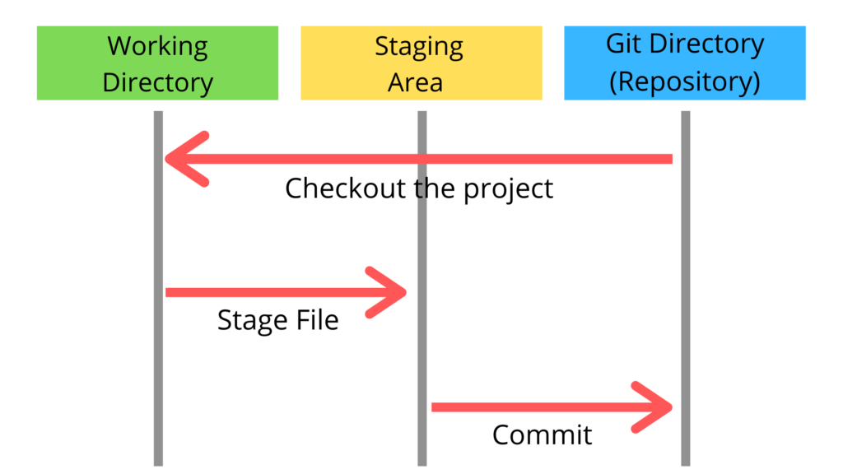
Three Stage Architecture

Slide 8
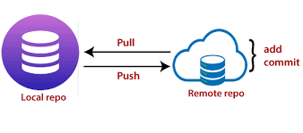
What is Git Push?
The push term refers to upload local repository content to a remote repository. Pushing is an act of transfer commits from your local repository to a remote repository.
Every time you push into the repository, it is updated with some interesting changes that you made. If we do not specify the location of a repository, then it will push to default location at origin master.

Slide 9
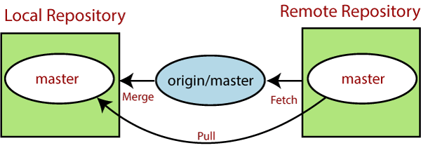
What is Git Pull?
The term pull is used to receive data from GitHub. It fetches and merges changes from the remote server to your working directory. The git pull command is used to pull a repository.Pull request is a process for a developer to notify team members that they have completed a feature.

Slide 10
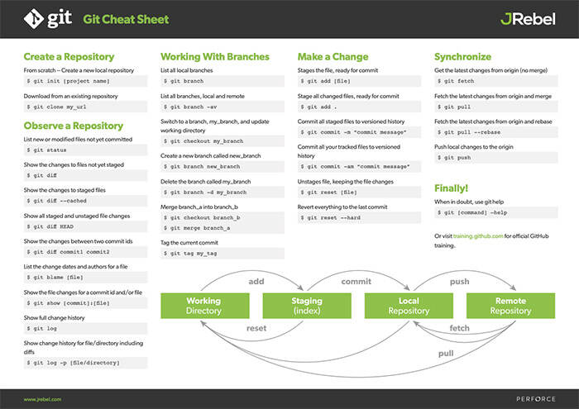
Git Cheat Sheet

